Slide 1
Mobility Trends
Observing mobility in variation with COVID19 waves and vaccination
Prashant Kumar
Om kumar Harnote
Ananay sood
Anirudha Prakash
Group 8

Slide 2
Data Preparation

Slide 3
Cleaning and Transformation
Dropped rows with null values across vaccination, cases and mobility data.
Data is then divided into four parts according to quarters and considering covid waves.
Location data-points were different in vaccination, cases and mobility datasets. Matched common locations and dropped unique values in both datasets.
Mean value for each quarter is considered.

Slide 4
Data Visualization

Slide 5
Data Visualization
Geopandas is used for visualization on Indian Map.
In case of mobility for each features visualization on Indian Map is done.
Vaccination and cases are also visualized in different quarters.

Slide 6
Mobility

Slide 7
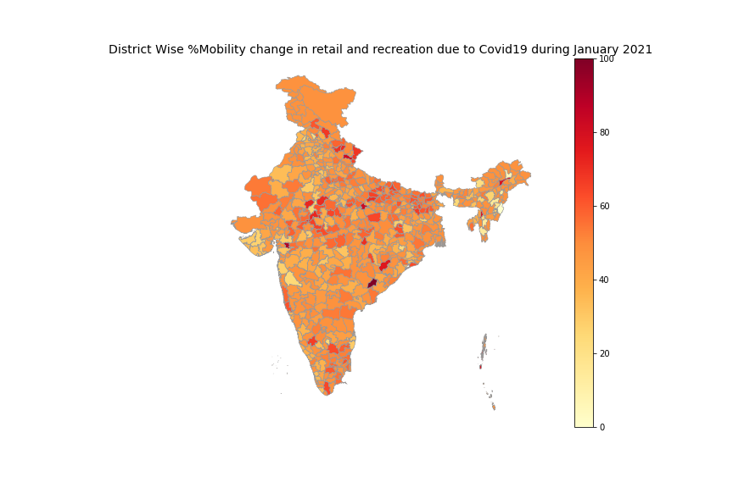

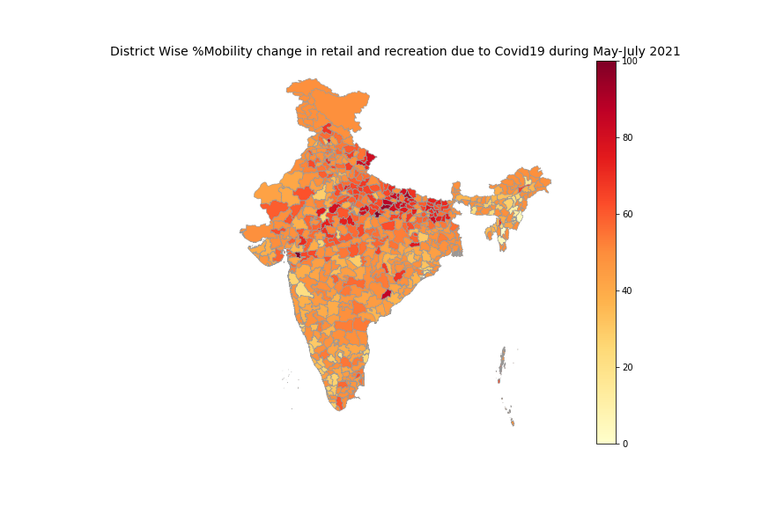


Retail and Recreation Average %Mobility change due to COVID19

Slide 8
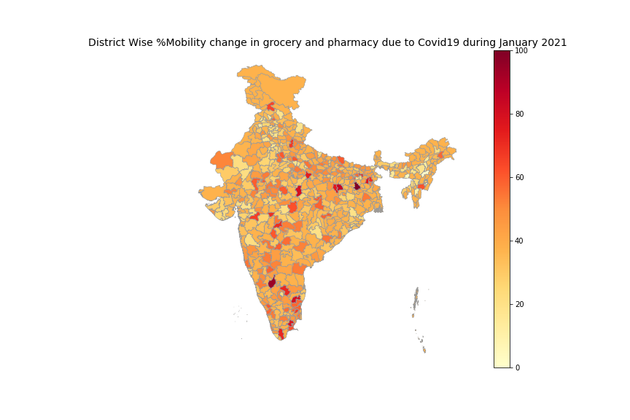
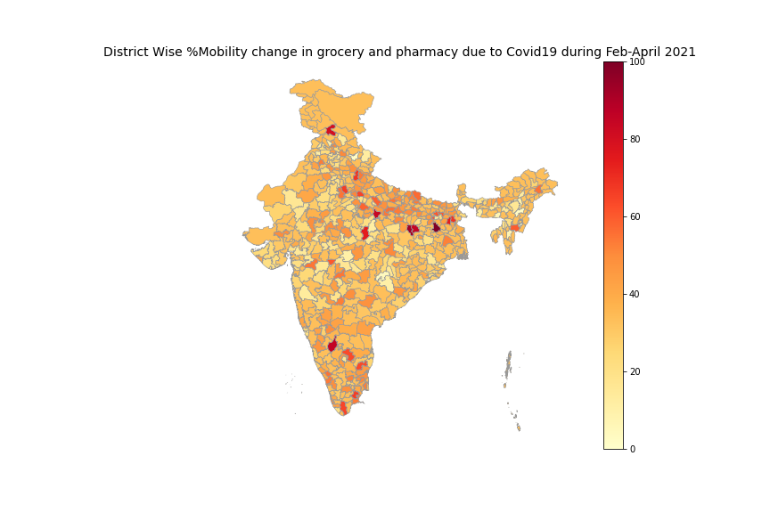



Grocery and Pharmacy Average %Mobility change due to COVID19

Slide 9
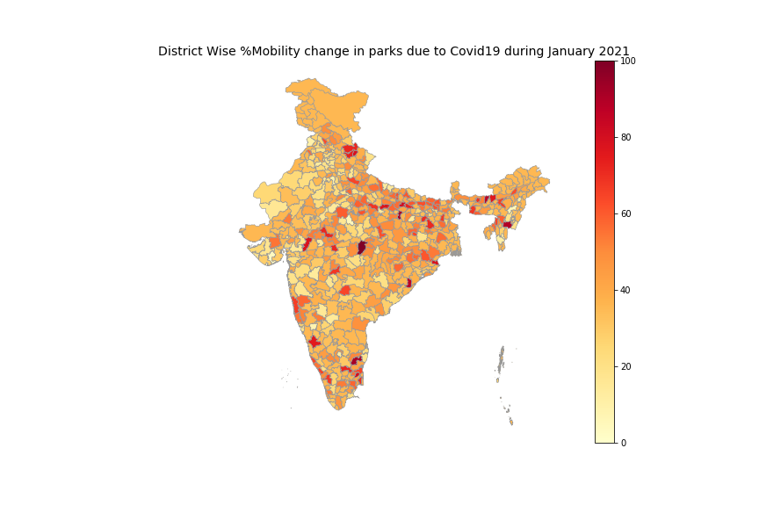


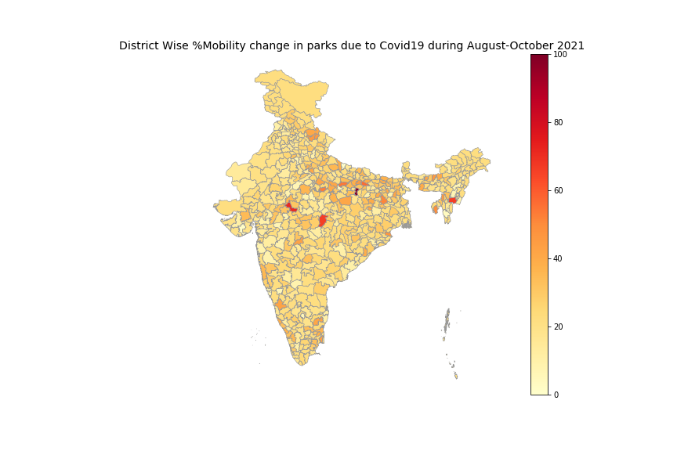

Parks Average %Mobility change due to COVID19

Slide 10
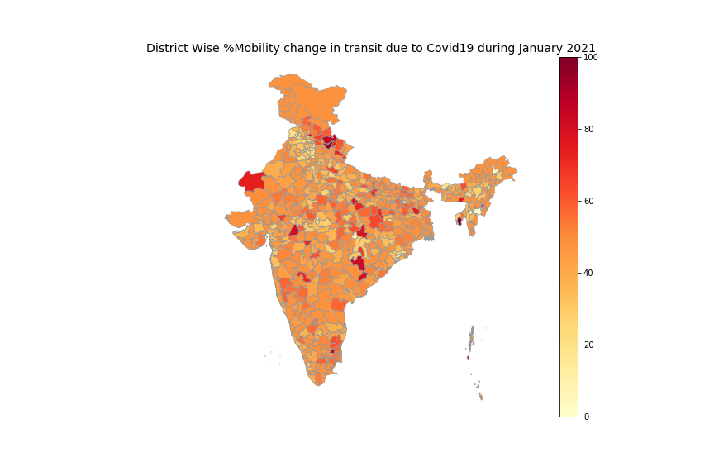


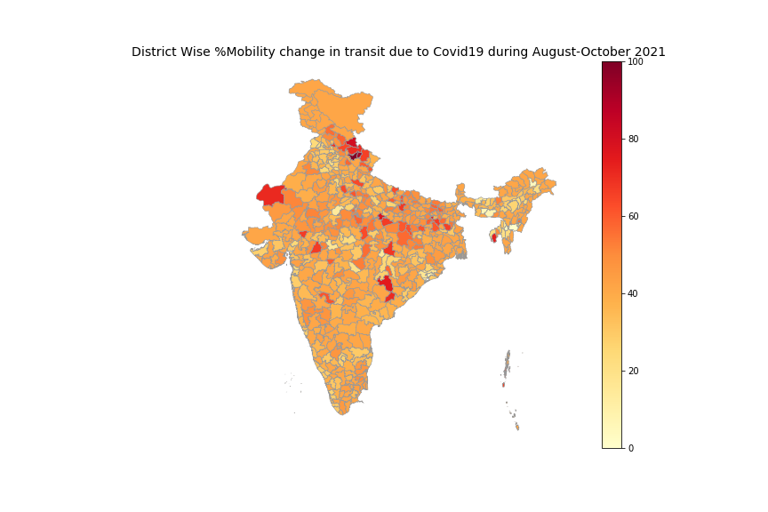

Transit Stations Average %Mobility change due to COVID19

Slide 11

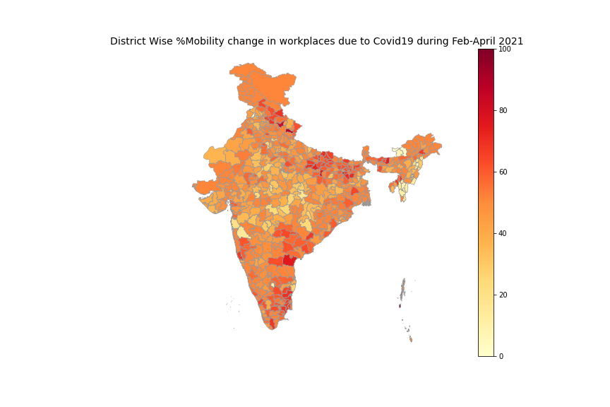
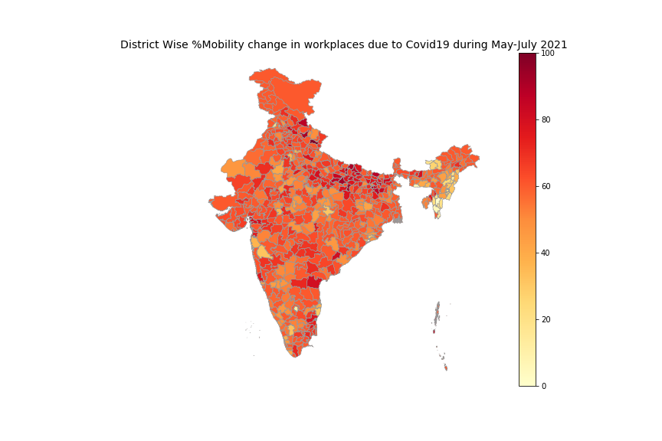

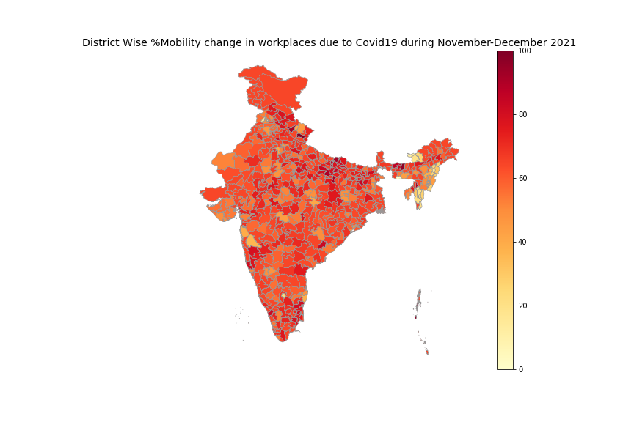
Workplaces Average %Mobility change due to COVID19

Slide 12
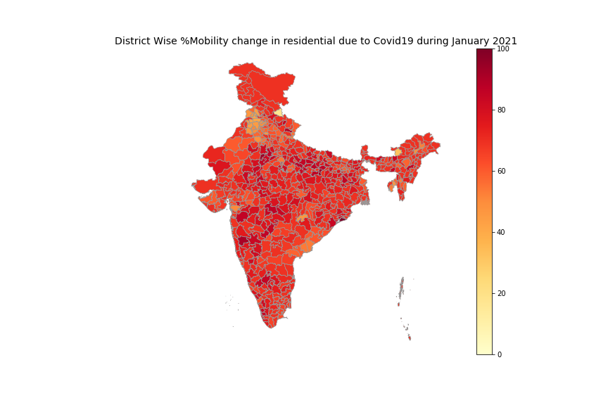
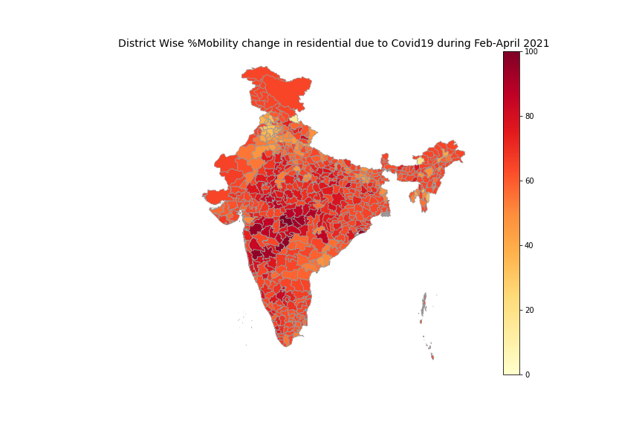
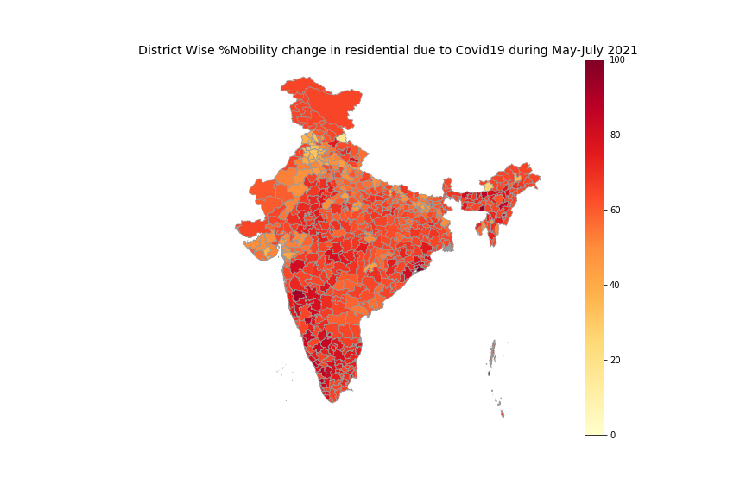


Residential Average %Mobility change due to COVID19

Slide 13
Retail and Recreation Average %Mobility change due to COVID19
Duration | Mean | std | Min | 25% | 50% | 75% | Max
January 2021 | 48.28 | 12.16 | 0.0 | 43.54 | 48.28 | 50.26 | 100.0
Feb-April 2021 | 37.75 | 9.89 | 0.0 | 33.54 | 37.75 | 37.75 | 100.0
May-July 2021 | 35.70 | 12.79 | 0.0 | 27.75 | 35.70 | 38.44 | 100.0
Aug-Oct 2021 | 48.30 | 12.67 | 0.0 | 42.59 | 48.30 | 48.60 | 100.0
Nov-Dec 2021 | 57.78 | 13.89 | 0.0 | 53.61 | 57.77 | 58.59 | 100.0

Slide 14
Vaccination

Slide 15
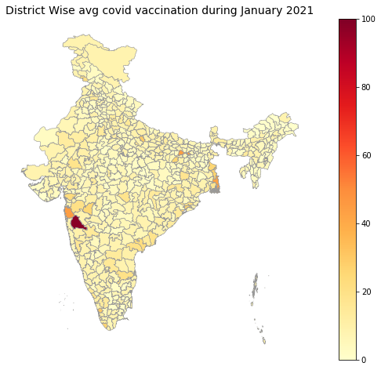
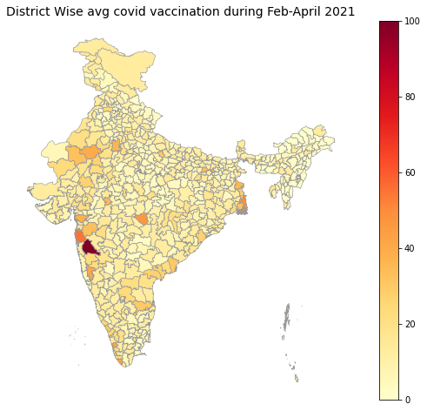

Slide 16
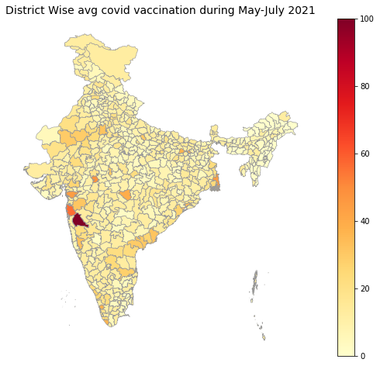
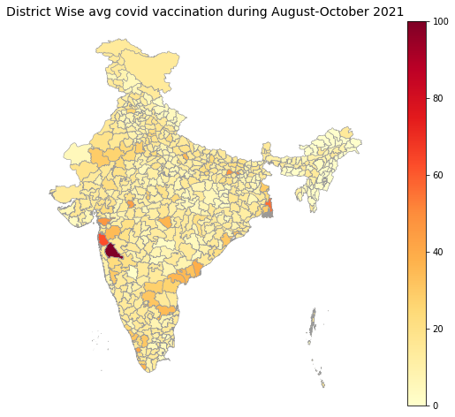

Slide 17
Cases

Slide 18
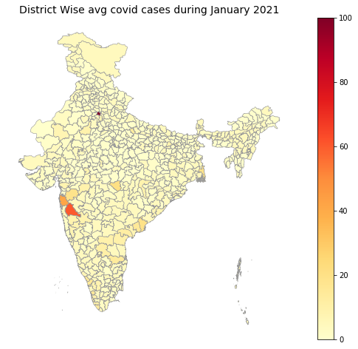


Slide 19

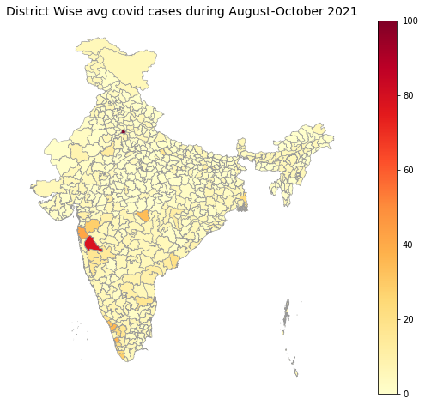

Slide 20
Correlation

Slide 21
Correlation of Mobility with Vaccination
Retail and Recreation mobility correlated highest with Vaccination in all quarters.
Value ranged between -28.9 to -19.91.
Mobility in Parks is second highly correlated with Vaccination.

Slide 22
Correlation of Mobility with Cases
Retail and Recreation mobility correlated highest with Cases in all quarters.
Value ranged between -28.05 to -26.86.
Mobility in Workplace is second highly correlated with Cases and Mobility in Parks is third.

Slide 23
Trends

Slide 24
Common Trend between Mobility, Cases and Vaccination

Slide 25
Common Trend between Mobility, Cases and Vaccination

Slide 26
Common Trend between Mobility, Cases and Vaccination

Slide 27
Common Trend between Mobility, Cases and Vaccination

Slide 28
Conclusion

Slide 29
Conclusion
Exactly similar trends can be seen between mobility, cases and vaccination.
During second wave which started in March 21, Maharashtra, Delhi and Kerala were highly affected.
The places which showed highest mobility, Average cases and Average Vaccination are Delhi, Bengaluru, Pune, Mumbai, Thane.

